Slide 1
Oral presentation
VICTOR MANUEL GALVAN COVARRUBIAS | TI 2-4
English II
Teacher Cinthya Rivera Diaz
https://youtu.be/MWv3cz57QQI

Slide 2
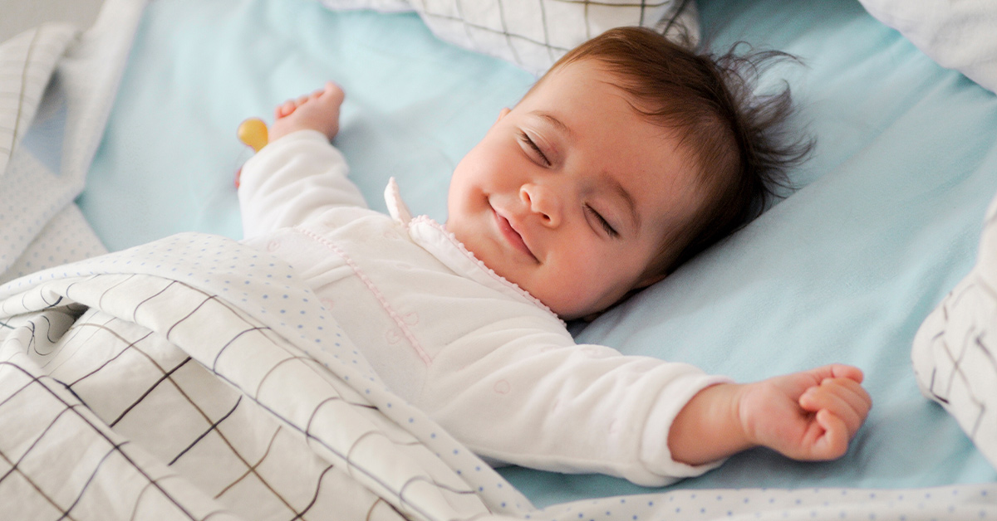

Slide 3
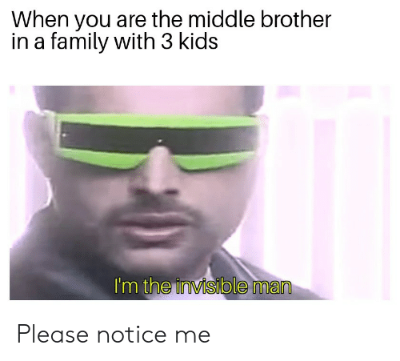

Slide 4
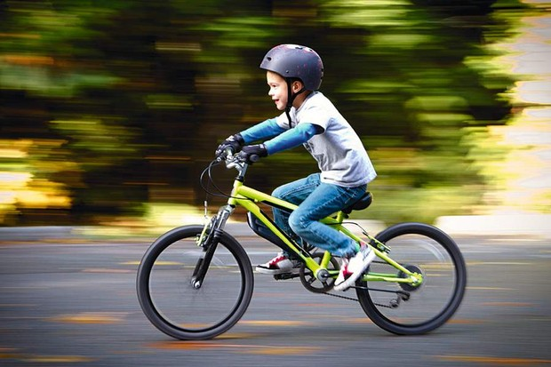

Slide 5
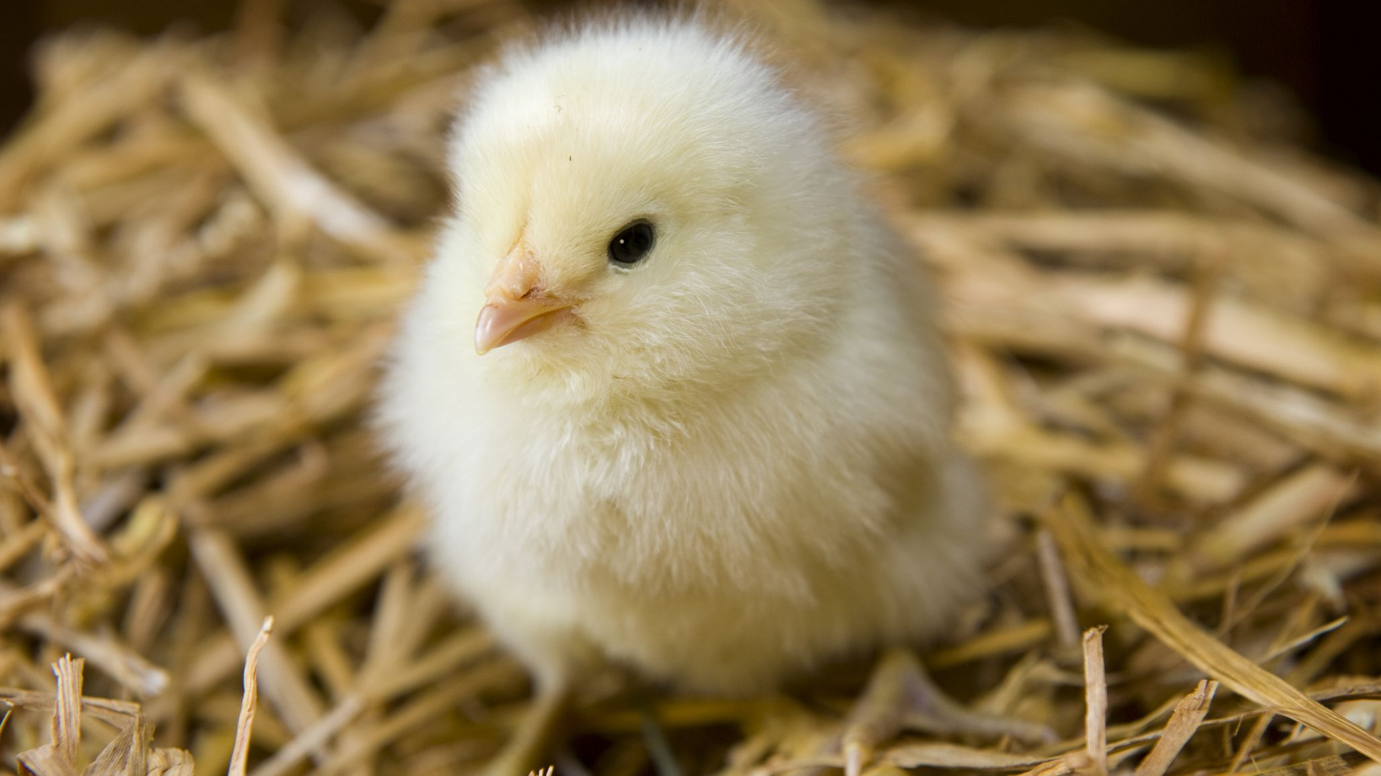

Slide 6
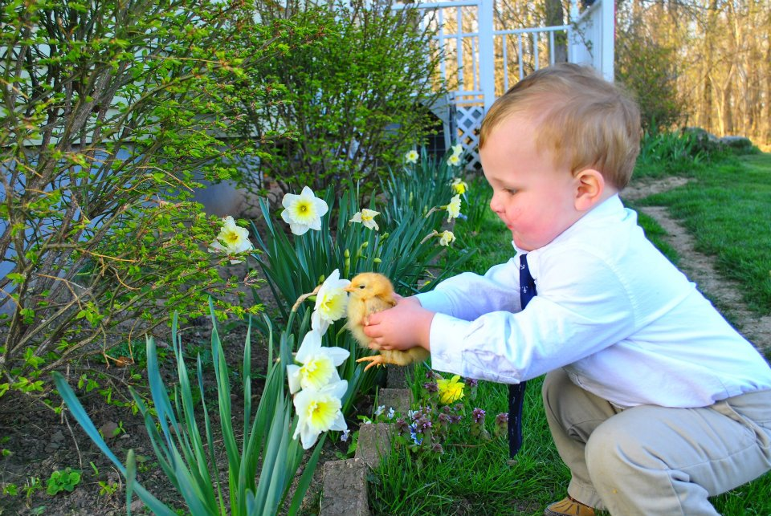

Slide 7
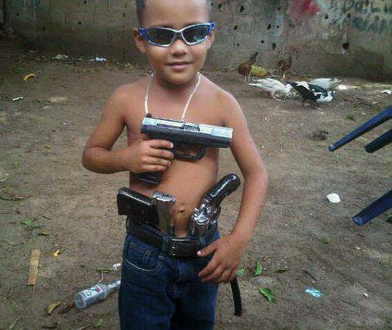

Slide 8
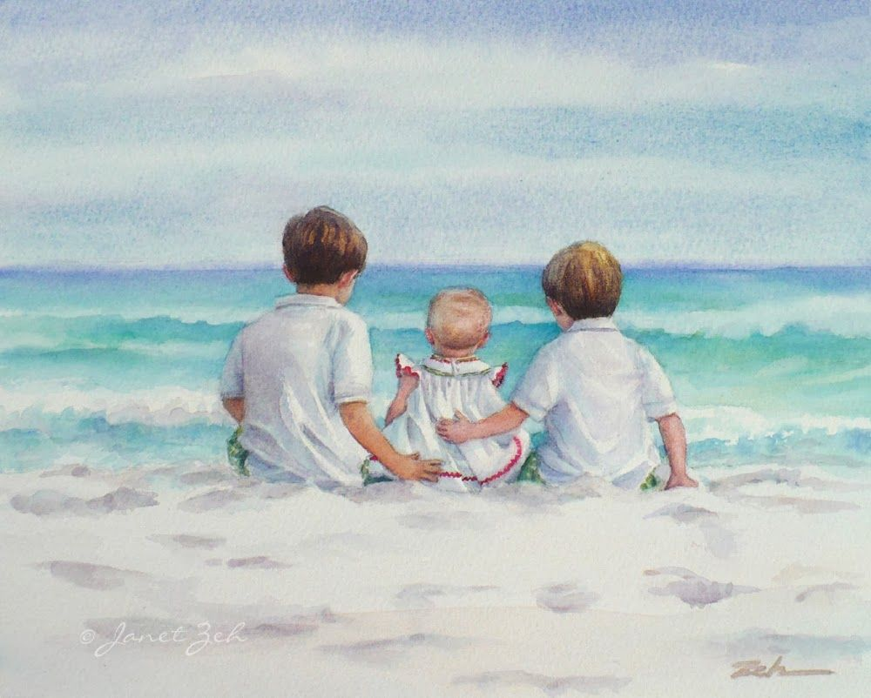

Slide 9


Slide 10


Slide 11
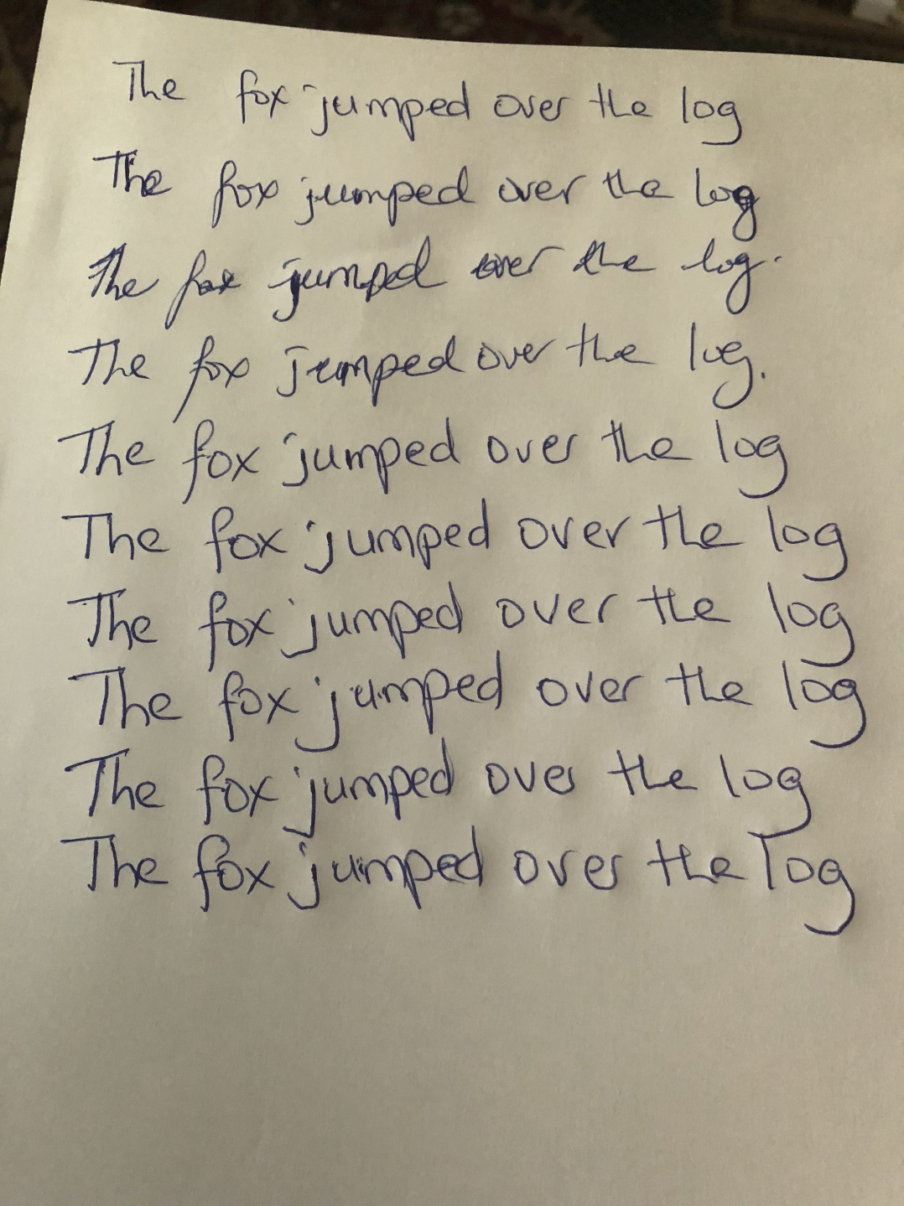

Slide 12


Slide 13


Slide 14
The end

